Slide 1
PowerShell Advanced Fundamentals

Slide 2
Introduction

Slide 3
Introduction
Björn Sundling
  bjorn.sundling@advania.com
  https://bsky.app/profile/bjompen.com
You?
  Get-Participant
  Get-Expectation

Slide 4
Introduction
Agenda
  git Started
  VS Code
  Filters, Functions and Advanced Functions
  PowerShell Classes
  Regex Intro
  API
  Error Handling
  Debugging
  Building Modules
  Testing with Pester

Slide 5
Introduction
Agenda (non technical)
  Chapter
  Lab
  Coffee break
  Start @ 9.00
  Lunch @ ~11.30
  Done @ ~16.00
  Voluntary recap @ ~8.30

Slide 6
Introduction
Bring Your Own Lab!
  It’s easier to understand your own issues

Slide 7
Introduction
How to do labs?
  Lab.md –No solutions.
  Detailed.md – Some help.
More than one way of solving an issue.
  “If it’s stupid and it works, it’s not stupid”
Run from file or change paths!
  $PSScriptRoot
  Dot source a file ’. .\MyFile.ps1’

Slide 8
Introduction
Lab 0
https://github.com/AdvaniaSE/PowerShellAdvancedFundamentals
  00. Install PowerShell, VSCode, Git, and create a GitHub account.

Slide 9
Try Along!
Try stuff
Break stuff
Fix stuff
Understand stuff

Slide 10
git Started

Slide 11
git Started
Why version control?
  Script-Folder problem
    v1
    v2
    v2.final
  Central location for main data
    Where's latest?
  Snapshot based - Go back and forth in time
  History of What, When and Whom
  Collaboration

Slide 12
git Started
git vs GitHub
  Git is a protocol
  GitHub is a Service
    (with many many alternatives!)

Slide 13
git Started
Your service provider – GitHub/Azure DevOps/BitBucket et. al.
  Fork
  Pull request / PR
  CLI
    GitHub CLI
    az devops

Slide 14
git Started
Only six commands!
  git status
    Show current git changes
  git init / git clone
    Create an empty repo or clone an existing “remote”
    HTTPS vs. SSH?
  git add
    Add one or more files for staging
  git pull
    Find and download “remote” changes
  git commit
    Create a snapshot
    -m ‘message’
      Add a commit message without entering vim…
  git push
    Push changes to remote

Slide 15
git Started
Working with branches
  Strategies
    GitHub Flow
    Git Flow
    Trunk based development / single branch
  Git checkout –b
    Create a branch and change to it directly
  Git branch
    Create a branch but stay on current one

Slide 16
git Started
Visual tools
  Start with CLI
  VS Code
  GitHub Desktop
  posh-git / OhMyPosh
  Gource

Slide 17
git Started
Lab 1
https://github.com/AdvaniaSE/PowerShellAdvancedFundamentals
  01. git Started
https://i.redd.it/8341g68g1v7y.png - Git cheat sheet

Slide 18
VSCode

Slide 19
VS Code
Why?
  Free
  Cross-platform
  Open source
  Microsoft standard

Slide 20
VS Code
Basic Features
  Open Folder
  ISE mode (for the old school PowerShell devs)
  Snippets / CoPilot integration
  git integration
  Extensions
    From PowerShell...
    ...via HTML previews....
    ..to live share!

Slide 21
VS Code
Editor Features
  Move row
  Duplicate row
  Comment
  Multi Cursor
  Bracket pair colorization

Slide 22
VS Code
PowerShell Integration
  Terminal
  IntelliSense
  Code-format
  Debugger

Slide 23
VS Code
F1 – The key to the kingdom.
Keybindings for all OS’s:
  https://code.visualstudio.com/docs/configure/keybindings#_keyboard-shortcuts-reference

Slide 24
Filters, Functions and Advanced Functions

Slide 25
Filters, Functions and Advanced Functions
Goal: Re-Use Code!
  Multiple copies are hard to maintain
  Never Copy & Paste code!
  Hiding details makes a script easier to read

Slide 26
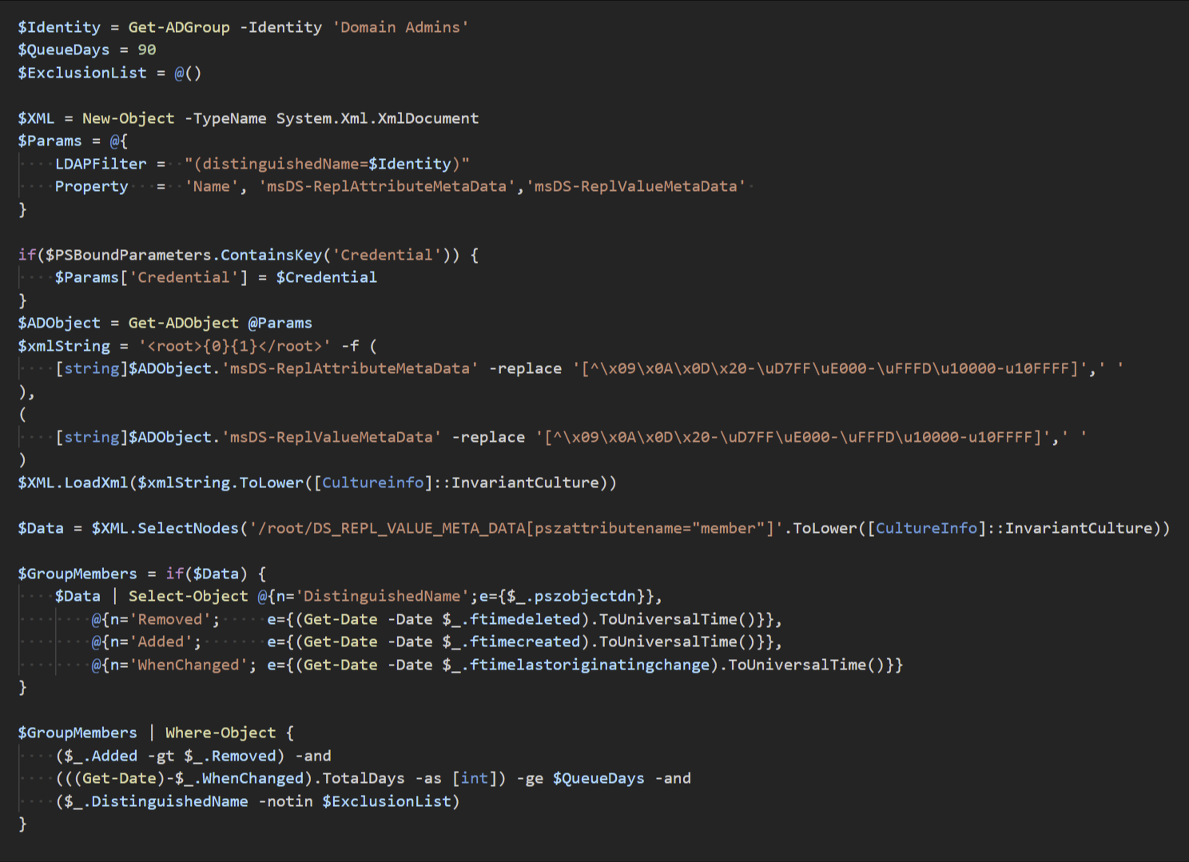
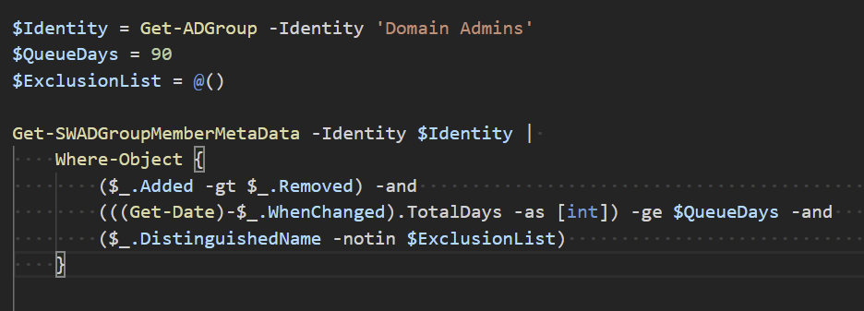
Filters, Functions and Advanced Functions
Example
  Just code
  Function and code

Slide 27
Filters, Functions and Advanced Functions
Verb-Noun
  Get-Verb
    (Better in PS7!)
  Unless you are writing “internal” functions.

Slide 28
Filters, Functions and Advanced Functions
Function scoped variables
  $PSBoundParameters
    Always available
    Only contains key/value of parameters
  $PSCmdlet
    Only in advanced functions
    Contains “everything” about a function execution
  $PSCommandPath
    Only in saved files
    Contains full path to .ps1/.psm1
  $PSScriptRoot
    Only in saved files
    Contains parent of .ps1/.psm1

Slide 29
Filters, Functions and Advanced Functions
Three Types of "functions"
  Filters
    Extremely uncommon
    Your own "Select" commands
    Behaves like a function with all code in the ‘process’ block
      Repeats once per input from pipeline

Slide 30
Filters, Functions and Advanced Functions
Three Types of "functions"
  Function
    Not for pipelines
    Easy to understand
    Good for "helpers“
    Can still use parameters, named or $args

Slide 31
Filters, Functions and Advanced Functions
Three Types of "functions"
  Advanced Function
    CmdletBinding
      ConfirmImpact
      DefaultParameterSetName
      HelpUri
      SupportsShouldProcess
    OutputType()

Slide 32
Filters, Functions and Advanced Functions
Three Types of "functions"
  Advanced Function
    Begin {}, Process {}, End {}
      (and clean {} if you are on 7.3 or later..)
      If not defined, all code is in the end {} block

Slide 33
Filters, Functions and Advanced Functions
Three Types of "functions"
  Advanced Function
    Rich Parameter support
      Metadata
        Mandatory
        Position
        Pipeline Input
        ParameterSetName
        Alias
        HelpMessage
        DontShow
      Type
        Implicit Casting
      Validation
        AllowNull()
        AllowEmptyString()
        ValidateCount(1,5)
        ValidateLength(1,5)
        ValidatePattern('+')
        ValidateScript( { Test-Path $_ } )
        ValidateSet( 'Apelsin', 'Banan', 'Clementin')
        ErrorMessage

Slide 34
Filters, Functions and Advanced Functions
Three Types of "functions"
  Advanced Function
    Switch-Parameters
      On / Off

Slide 35
Filters, Functions and Advanced Functions
Lab 2
https://github.com/AdvaniaSE/PowerShellAdvancedFundamentals
  02. Functions

Slide 36
PowerShell Classes

Slide 37
PowerShell Classes
Comes from DSC – Dynamic State Configuration
More Dev-Oriented

Slide 38
PowerShell Classes
[ClassName]::New()
New-Object -TypeName

Slide 39
PowerShell Classes
Only output from return
Class
  Property
  Method
  Constructor
  Hidden Property
  Static
Can also do
  Inheritance
  Interfaces
  More….

Slide 40
PowerShell Classes
Enum
  enum <name> {}
Bitflag-like
  [flags()] enum <name> {}

Slide 41
PowerShell Classes
Lab 3
https://github.com/AdvaniaSE/PowerShellAdvancedFundamentals
  03. Classes

Slide 42
Regex

Slide 43
Regex
Pattern matching
  Validating input
  Searching for part of text
    Log searching w. Select-String
    Phone number
    Birth date
  Replacing text

Slide 44
Regex
-Match
  $matches variable
[regex]::Match / [regex]::Matches
  Case sensitive!

Slide 45
Regex
Use web tools
  But remember to check the RegEx flavors – PowerShell uses .Net
  Regular Expression Language - Quick Reference
    Microsoft Learn
  Regex101.com
    Online regex tester and debugger: PHP, PCRE, Python, Golang and JavaScript

Slide 46
Regex
Special characters
  []$.|?*+()

Slide 47
Regex
Character classes
  Word - \w
  Space -\s
  Digit - \d
  Character group - [A-Za-z0-9]
  Unicode - \P{IsGreek}
Negated classes
  Word - \W
  Space -\S
  Digit - \D

Slide 48
Regex
Quantifiers
  ?
  *
  +
  {2}
  {2,}
  {2,5}

Slide 49
Regex
Groups
  Subexpression My name is (+)
  Named Subexpression My name is (?<name>+)

Slide 50
Regex
Lab 4
https://github.com/AdvaniaSE/PowerShellAdvancedFundamentals
  04. Regex

Slide 51
API
(yeah, ok, web APIs…)

Slide 52
API
What is an API?
Rest and SOAP.

Slide 53
API
Invoke-WebRequest
  Raw data results
Invoke-RestMethod
  Parses results
  Better in PowerShell 7
Entirely different backend in PS7
  Behaves different. Verify your code.

Slide 54
API
Authentication
  Basic
    Username / password
    PAT - Personal Access Tokens
  OAUTH
  -UseDefaultCredentials

Slide 55
API
TLS
  [Net.ServicePointManager]::SecurityProtocol = [Net.SecurityProtocolType]::Tls12
Encoding
  [console]::OutputEncoding = [System.Text.Encoding]::UTF8

Slide 56
API
Lab 5
https://github.com/AdvaniaSE/PowerShellAdvancedFundamentals
  05. API

Slide 57
Error Handling

Slide 58
Error Handling
Two kinds of errors
  Terminating
    Stops the command or pipeline
      Get-Item 'BadFile.bad' -ErrorAction Stop ; Write-Host 'bad file is bad'
  Non-terminating
    Continues the command or pipeline
      Get-Item 'BadFile.bad' ; Write-Host 'bad file is bad'
(actually three – or even more - Statement terminating and script terminating)
  https://stackoverflow.com/a/72802148

Slide 59
Error Handling
ErrorAction / ErrorActionPreference
ErrorView
Get-Error
(Coming soon Available in 7.5 – RecommendedAction!)

Slide 60
Error Handling
Try/Catch/Finally
Trap{}

Slide 61
Error Handling
Lab 6
https://github.com/AdvaniaSE/PowerShellAdvancedFundamentals
  06. Error Handling
The art of throwing errors - Emrys MacInally - PSConfEU 2024

Slide 62
Debugging

Slide 63
Debugging
Hard see what happens inside your code
  Better than “Write-Host” 😉
Can debug other and external processes

Slide 64
Debugging
VSCode Breakpoints
  Line
    Condition
    HitCount
    Log
  Watch window

Slide 65
Debugging
Set-PSBreakpoint
  Line
    Script
    Action
    Column
  Command
    Script
    Action
  Variable
    Script
    Action
    Mode

Slide 66
Debugging
Lab 7
https://github.com/AdvaniaSE/PowerShellAdvancedFundamentals
  07. Debugging

Slide 67
Building Modules

Slide 68
Building Modules
Basic
  psm1
  Folder name
  Manifest

Slide 69
Building Modules
Splitting code
  Private
  Public
  Class

Slide 70
Building Modules
Combining code
  Faster load time
  Looking good

Slide 71
Building Modules
Help
  Comment Based
  External Help

Slide 72
Building Modules
Module helper tools
  ModuleBuilder - Combine and build your modules
  PlatyPS - Write help in Markdown
  Invoke-Build - Build automation tool
  Sampler - All of the above

Slide 73
Building Modules
Modules can be done in C# or F#
Publish to PSGallery
  Possible to create your own

Slide 74
Building Modules
Lab 8
https://github.com/AdvaniaSE/PowerShellAdvancedFundamentals
  08. Building Modules

Slide 75
Testing Code with Pester

Slide 76
Testing Code with Pester
Testing Code
  Unit
  Integration

Slide 77
Testing Code with Pester
Commands
  Describe
  Context
  It
  Should
  Mock

Slide 78
Testing Code with Pester
TDD
Infrastructure Testing

Slide 79
Testing Code with Pester
Lab 9
https://github.com/AdvaniaSE/PowerShellAdvancedFundamentals
  09. Pester

Slide 80
PowerShell Advanced Fundamentals
Bjorn.sundling@advania.com

